Slide 1
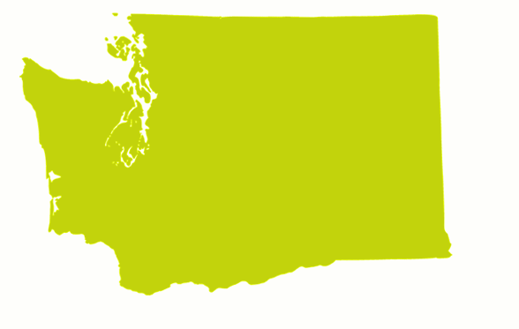

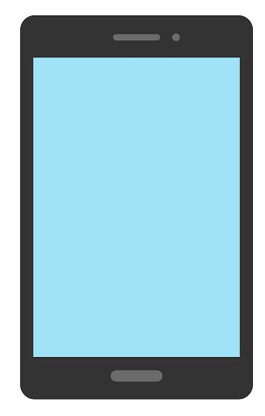
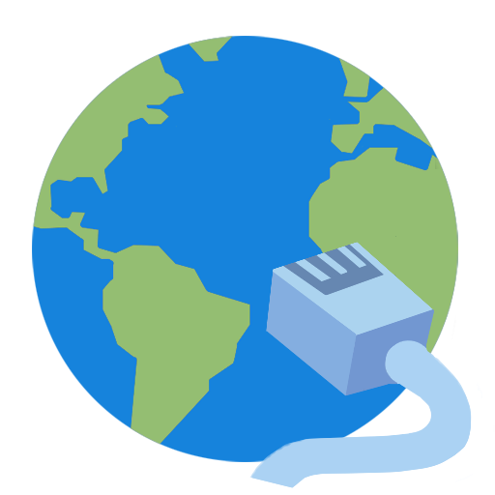
(Data from Digital Nation 2015)
Digital Nation
Washington State Profile
Demographics
Profile of Internet Households
Age
Why
25 24 19 25 7
% % % % %
don’t you want to use computer
and internet at home?
Devices people use to get on internet:
Gender
Household Size
>= 72
53-71
39-52
23-38
7-22
49.8%
50.2%
57% - Phone
48% - Laptop
37% - Desktop
35% - TV Box
34% - Tablet
2% - Wearable Device
Avg. 3.3
7%
Other
reasons
32%
Don’t
need it
26%
No device can’t afford
17%
Not interested
Digital Divides
Income and Education Level
In the Nation and Washington State: 593,679 households are not using the internet
$
Households with access to internet and computer have annual median HH income of 75k.
(Average Overall is 63k)
19%
Of adults (22+) don’t use internet, and 25% don’t use it at home.
31%
Of people 15 or over with HS degree or less don’t use internet.
31%
Of people 15 or over with a disability don’t use internet.
36%
Of people over 65 or older don’t use internet.
Avg. $75,000
- 25% hold a High School Degree
- 33% hold a Bachelor’s or higher degree
How do the Children (3 - 12 years old)
Most used mobile device:
Phone
77% use phone
55% use laptop
3% use wearable devices
Location of using Internet:
Pre-schoolers School age
Home WA 46.4% 67.8%
US 40.7% 60%
School WA 8.3% 49.3%
US 17% 49%
use internet ?
Major reasons children don’t use internet:
77.5% of children have access to internet
1. Don’t need it
2. Not interested
- Older children use internet more often at school.
Notes:
Check all numbers against Map

